Slide 1


Module 2 : Part 2
Searching Strategies
CSC 604 : Artificial Intelligence

Slide 2
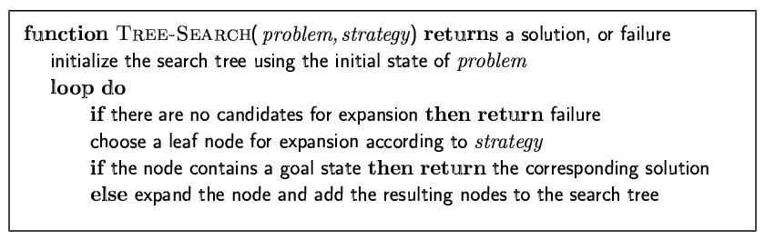
Tree search algorithms
Basic idea:
offline, simulated exploration of state space by generating successors of already-explored states (a.k.a.~expanding states)

Slide 3
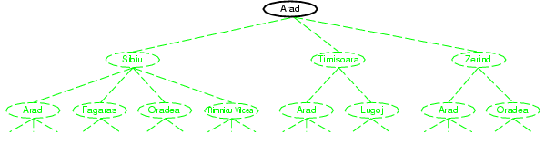
Tree search example

Slide 4
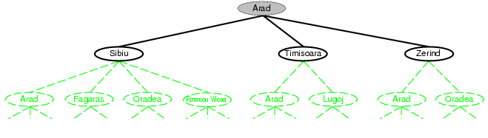
Tree search example

Slide 5
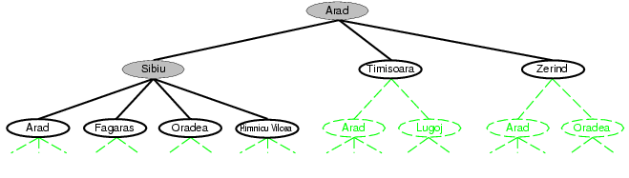
Tree search example

Slide 6
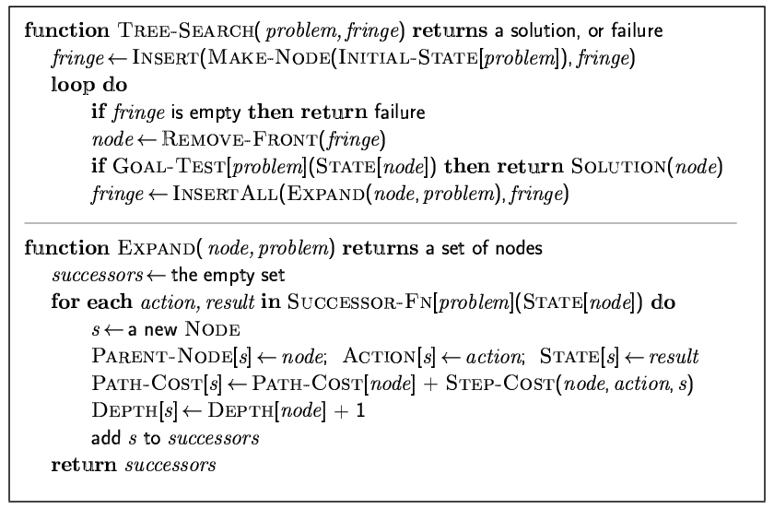
Implementation: general tree search

Slide 7
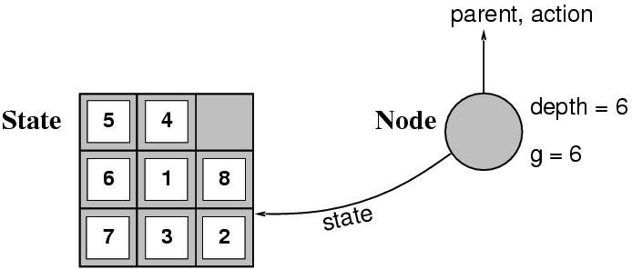
Implementation: states vs. nodes
A state is a (representation of) a physical configuration
A node is a data structure constituting part of a search tree includes state, parent node, action, path cost g(x), depth
The Expand function creates new nodes, filling in the various fields and using the SuccessorFn of the problem to create the corresponding states.

Slide 8
Search strategies
We can evaluate an algorithm’s performance in four ways:
Completeness: Is the algorithm guaranteed to find a solution when there is one and to correctly report failure when there is not?
Cost optimality: Does it find a solution with the lowest path cost of all solutions?
Time complexity: How long does it take to find a solution? This can be measured in seconds, or more abstractly by the number of states and actions considered.
Space complexity: How much memory is needed to perform the search?
Time and space complexity are measured in terms of
b: branching factor or number of successor of a node that need to be considered.
d: depth of the least-cost solution
m: maximum depth of the state space (may be ∞)

Slide 9
Searching Strategies
•Heuristic search(informed search):Strategies that know whether one goal state is more promising than another
•Techniques: Greedy Best First Search, A* Algorithm
•There is no guarantee that solution is found.
•Blind search(uninformed search) it means they have no additional information about states beyond that provided in problem definition
•Techniques : Breadth First Uniform Cost ,Depth first, Depth limited, Iterative Deepening search.
••Guarantees solution.

Slide 10
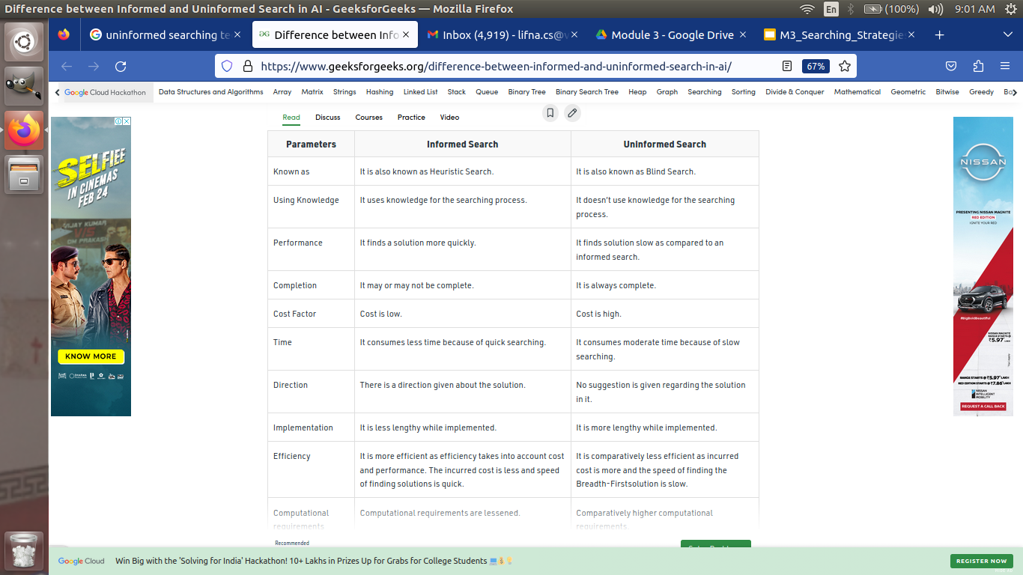

Slide 11


Slide 12
Uninformed search strategies
Uninformed search strategies use only the information available in the problem definition
Breadth-first search
Uniform-cost search
Depth-first search
Depth-limited search
Iterative deepening search
Bidirectional Search

Slide 13
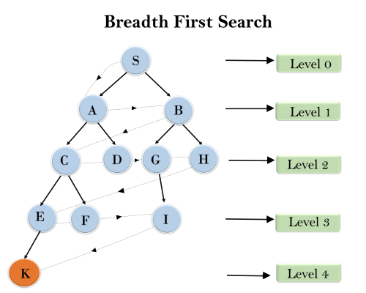
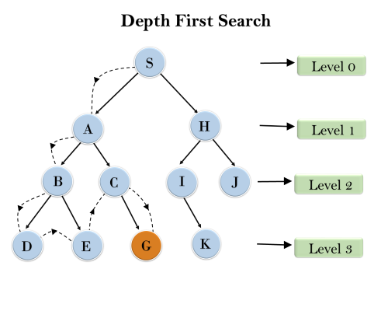
Examples

Slide 14
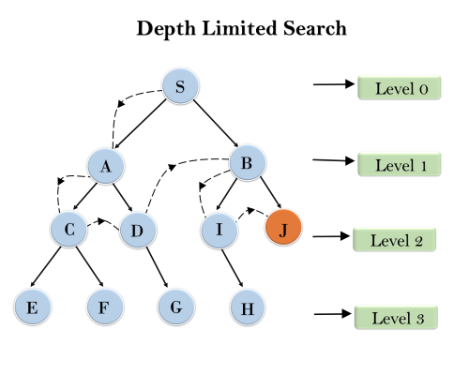
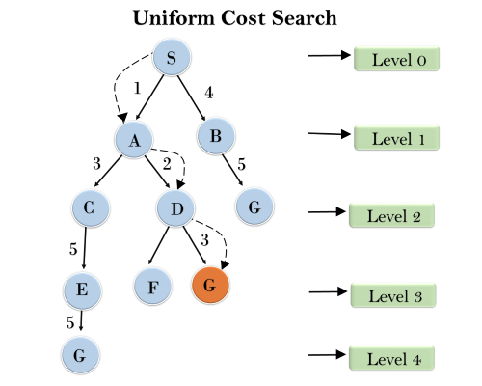
Examples

Slide 15
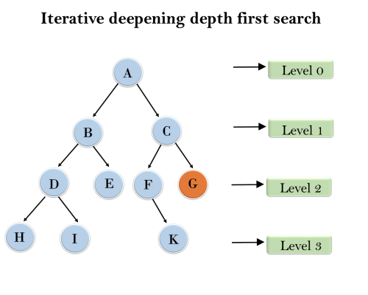
Examples
1'st Iteration-----> A
2'nd Iteration----> A, B, C
3'rd Iteration------>A, B, D, E, C, F, G
4'th Iteration------>A, B, D, H, I, E, C, F, K, G
In the fourth iteration, the algorithm will find the goal node.

Slide 16
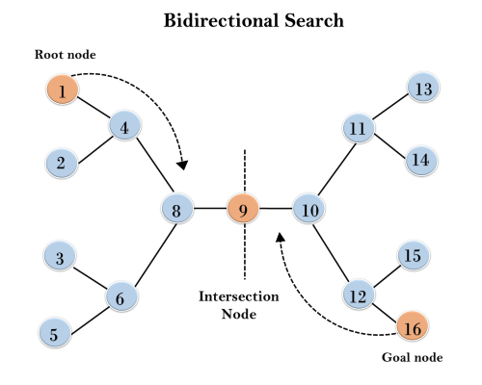
Examples

Slide 17
Breadth-first search
Breadth-first search is a simple strategy in which the root node is expanded first, then all the successors of the root node are expanded next, then their successors, and so on.
Implementation:
fringe is a FIFO queue, i.e., new successors go at end

Slide 18
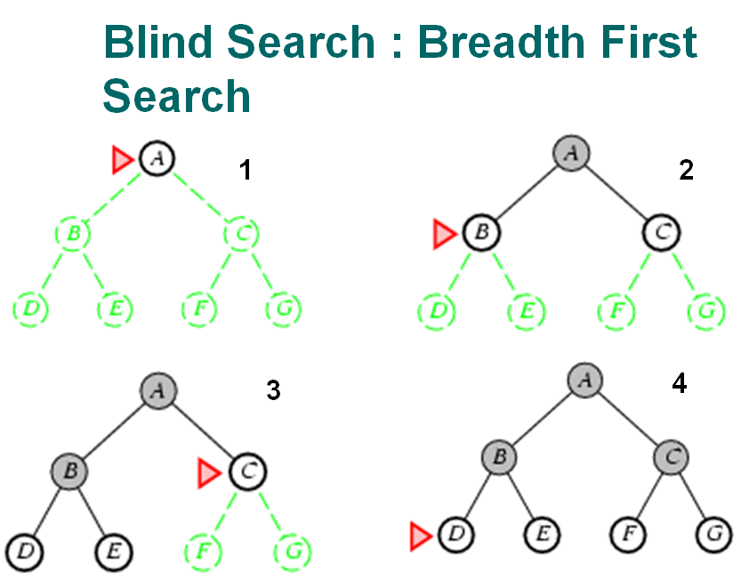

Slide 19
Properties of breadth-first search
Complete? Yes (if b is finite)
Time? 1+b+b²+b³+… +b^{d} = O(b^{d})
Space? O(b^{d}) (keeps every node in memory)
Optimal? Yes (if cost = 1 per step)
note:Space is the bigger problem (more than time)

Slide 20
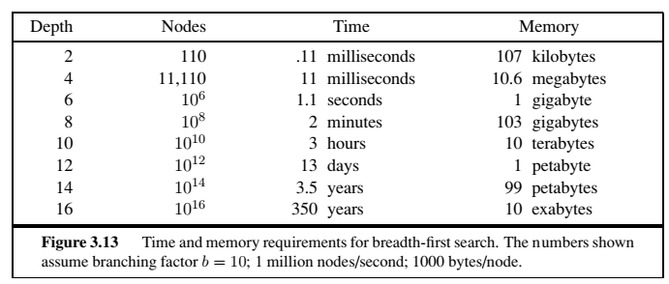

Slide 21
Uniform-cost search
When all step costs are equal, breadth-first search is optimal because it always expands the shallowest unexpanded node.
what if cost of all possibilities is not same?
By a simple extension, we can find an algorithm that is optimal
uniform-cost search expands the node n with the lowest path cost g(n).
Implementation: using priority queue ordered by g.

Slide 22
Uniform-cost search does not care about the number of steps a path has, but only about their total cost. Therefore, it will get stuck in an infinite loop if it ever expands a node that has a zero cost action leading back to same state.
Completeness is guaranteed provided the cost of every step exceeds some small positive constant ε.
Uniform-cost search is guided by path costs rather than depths

Slide 23
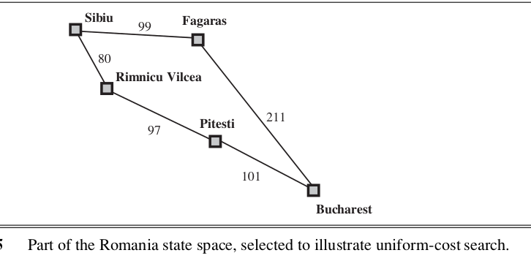

Slide 24
Uniform-cost search
Complete? Yes, if step cost ≥ ε
Time? O(b^{1+⎣C*/ ε⎦}) where C* is the cost of the optimal solution and ε a lower bound on the cost of each action ,ε >0
Space? O(b^{1+⎣C*/ ε⎦}) where C* is the cost of the optimal solution and ε a lower bound on the cost of each action ,ε >0
Optimal? Yes – nodes expanded in increasing order of g(n)

Slide 25
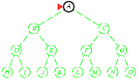
Depth-first search
Expand deepest unexpanded node
Implementation:
fringe = LIFO queue, i.e., put successors at front

Slide 26
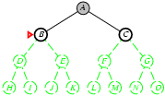
Depth-first search
Expand deepest unexpanded node
Implementation:
fringe = LIFO queue, i.e., put successors at front

Slide 27
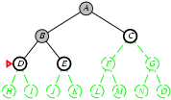
Depth-first search
Expand deepest unexpanded node
Implementation:
fringe = LIFO queue, i.e., put successors at front

Slide 28
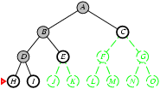
Depth-first search
Expand deepest unexpanded node
Implementation:
fringe = LIFO queue, i.e., put successors at front

Slide 29
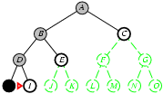
Depth-first search
Expand deepest unexpanded node
Implementation:
fringe = LIFO queue, i.e., put successors at front

Slide 30
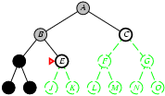
Depth-first search
Expand deepest unexpanded node
Implementation:
fringe = LIFO queue, i.e., put successors at front

Slide 31
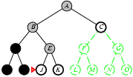
Depth-first search
Expand deepest unexpanded node
Implementation:
fringe = LIFO queue, i.e., put successors at front

Slide 32
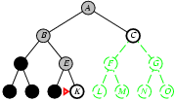
Depth-first search
Expand deepest unexpanded node
Implementation:
fringe = LIFO queue, i.e., put successors at front

Slide 33
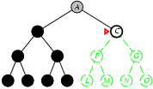
Depth-first search
Expand deepest unexpanded node
Implementation:
fringe = LIFO queue, i.e., put successors at front

Slide 34
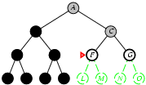
Depth-first search
Expand deepest unexpanded node
Implementation:
fringe = LIFO queue, i.e., put successors at front

Slide 35
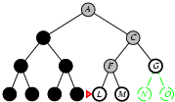
Depth-first search
Expand deepest unexpanded node
Implementation:
fringe = LIFO queue, i.e., put successors at front

Slide 36
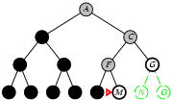
Depth-first search
Expand deepest unexpanded node
Implementation:
fringe = LIFO queue, i.e., put successors at front

Slide 37
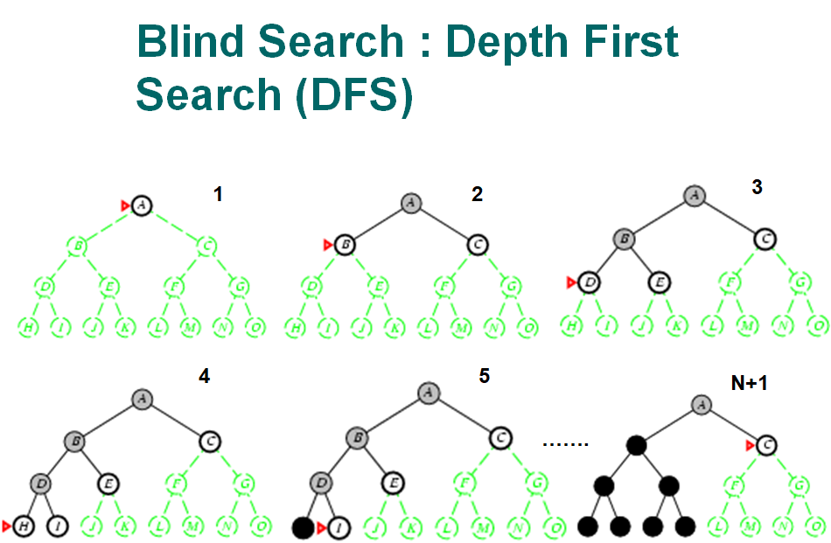

Slide 38
Properties of depth-first search
Complete? No: fails in infinite-depth spaces, spaces with loops
Modify to avoid repeated states along path complete in finite spaces
Time? O(bm): terrible if m is much larger than d but if solutions are dense, may be much faster than breadth-first
Space? O(bm), i.e., linear space!
Optimal? No

Slide 39
Depth-limited search(DLS)
The embarrassing failure of depth-first search in infinite state spaces can be alleviated by supplying depth-first search with a predetermined depth limit l.
Nodes at depth l are treated as if they have no successors.
The depth limit solves the infinite-path problem.

Slide 40
Depth-limited search(DLS)
It also introduces an additional source of incompleteness if we choose l < d, that is, the shallowest goal is beyond the depth limit.
(This is likely when d is unknown.)
Depth-limited search will also be nonoptimal if
we choose l > d.
Time complexity : O(b^{l})
Space complexity: O(bl).
Depth-first search can be viewed as a special case of depth-limited search with =∞.

Slide 41
Iterative deepening search
Iterative deepening search (or iterative deepening depth-first search) is often used in combination with depth-first tree search, that finds the best depth limit.
It does this by gradually increasing the limit—first 0, then 1, then 2, and so on—until a goal is found.
This will occur when the depth limit reaches d, the depth of the shallowest goal node.
Iterative deepening combines the benefits of depth-first and breadth-first search. Like depth-first search, its memory requirements are modest: O(bd)

Slide 42
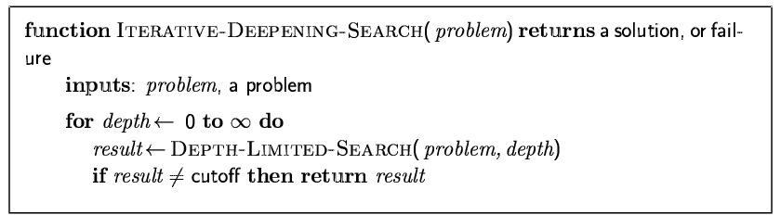
Iterative deepening search

Slide 43
Iterative deepening search may seem wasteful because states near the top of the search tree are re-generated multiple times.
But for many state spaces, most of the nodes are in the bottom level, so it does not matter much that the upper levels are repeated.
In an iterative deepening search, the nodes on the bottom level (depth d) are generated once, those on the next-to-bottom level are generated twice, and so on, up to the children of the root, which are generated d times

Slide 44
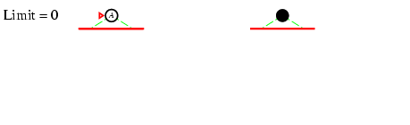
Iterative deepening search l =0

Slide 45
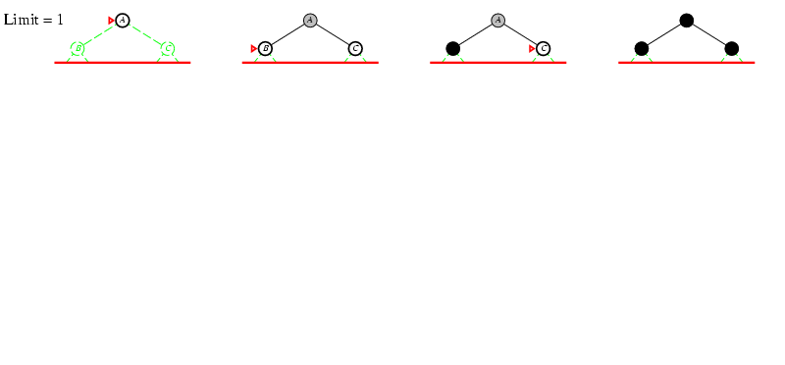
Iterative deepening search l =1

Slide 46
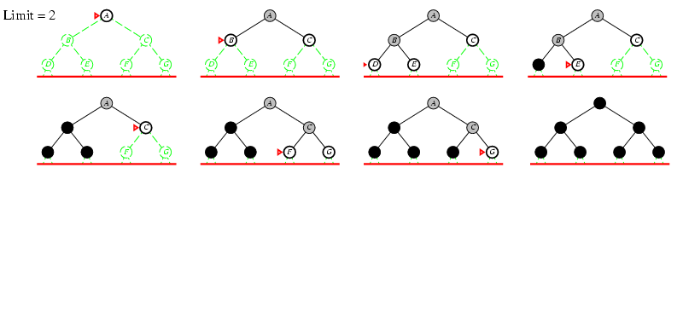
Iterative deepening search l =2

Slide 47
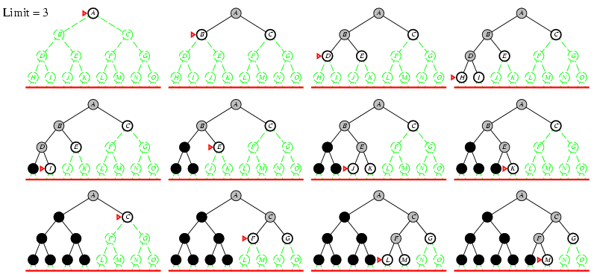
Iterative deepening search l =3

Slide 48
Properties of iterative deepening search
Complete? Yes
Time? d b¹ + (d-1)b² + (d-2)b³… + b^{d} = O(b^{d})
Space? O(bd)
Optimal? Yes, if step cost = 1

Slide 49
Iterative deepening search
In an iterative deepening search, the nodes on the bottom level (depth d) are generated once, those on the next-to-bottom level are generated twice, and so on, up to the children of the root, which are generated d times. So the total number of nodes generated in the worst case is
N(IDS) = d b¹ + (d-1)b² + (d-2)b³… + b^{d} = O(b^{d}), which gives a time complexity of O(b ^{d} )—
For example, if b = 10 and d = 5, the numbers are
N(IDS) = 50+400+3,000+20,000+100,000 = 123,450
N(BFS) = 10+100+1,000+10,000+100,000 = 111,110.
In general, iterative deepening is the preferred uninformed search method when the search state space is larger than can fit in memory and the depth of the solution is not known.

Slide 50
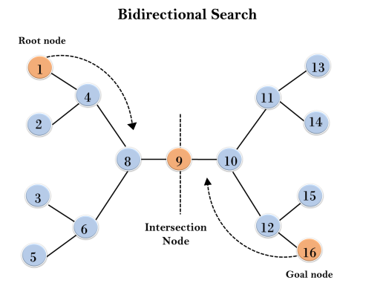
Bidirectional Search

Slide 51
Bidirectional Search
Completeness: Bidirectional Search is complete if we use BFS in both searches.
Time Complexity: Time complexity of bidirectional search using BFS is O(b^{d/2}).
Space Complexity: Space complexity of bidirectional search is O(b^{d/2}).
Optimal: Bidirectional search is Optimal.

Slide 52
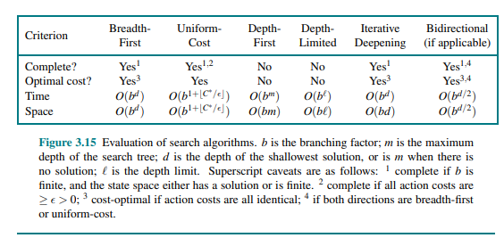
Summary of algorithms

Slide 53
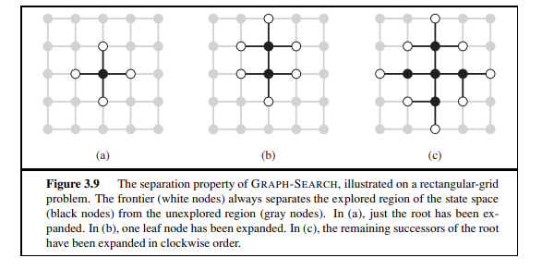
Repeated states
Failure to detect repeated states can turn a linear problem into an exponential one!

Slide 54
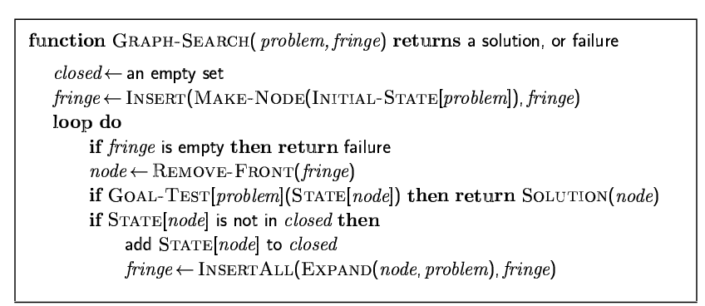
Graph search

Slide 55
Avoiding Repeated States
Do not return to the parent state (e.g., in 8 puzzle problem, do not allow the Up move right after a Down move)
Do not create solution paths with cycles
Do not generate any repeated states (need to store and check a potentially large number of states)
This is done by keeping a list of "expanded states" i.e., which remembers every expanded node.
This entails removing states from the "enqueued list" and placing them on an "expanded list"

Slide 56
Informed (Heuristic) Search Strategies
It uses problem-specific knowledge beyond the definition of the problem itself
can find solutions more efficiently than can an uninformed strategy.
It uses heuristic cost .
Important aspect: formation of heuristic function (h(n)).
Heuristic function : additional knowledge to guide searching strategy (short cut).

Slide 57
Cost???
g(n) = the cost of getting from the initial node to n.
h(n) = the estimate, according to the heuristic function, of the cost of getting from n to the goal node.
f(n) = g(n) + h(n); intuitively, this is the estimate of the best solution that goes through n.

Slide 58
OPEN AND CLOSED LIST
INFORMED SEARCH uses two lists:
the OPEN list - track nodes that need be examined,
the CLOSED list - track of nodes that are already examined.
Initially, the OPEN list contains just the initial node, and the CLOSED list is empty.
Each node n in the graph maintains the following additional information:
g(n) = the cost of getting from the initial node to n.
h(n) = heuristic cost from n to the goal node.
f(n) = g(n) + h(n) total cost

Slide 59
Best-first search
In Best-first search a node is selected for expansion based on an evaluation function, f(n). and here f(n)=g(n)
The evaluation function is construed as a cost estimate, so the node with the lowest evaluation is expanded first.
The implementation of best-first graph search is identical to that for uniform-cost search except for the use of f instead of g to order the priority queue.

Slide 60
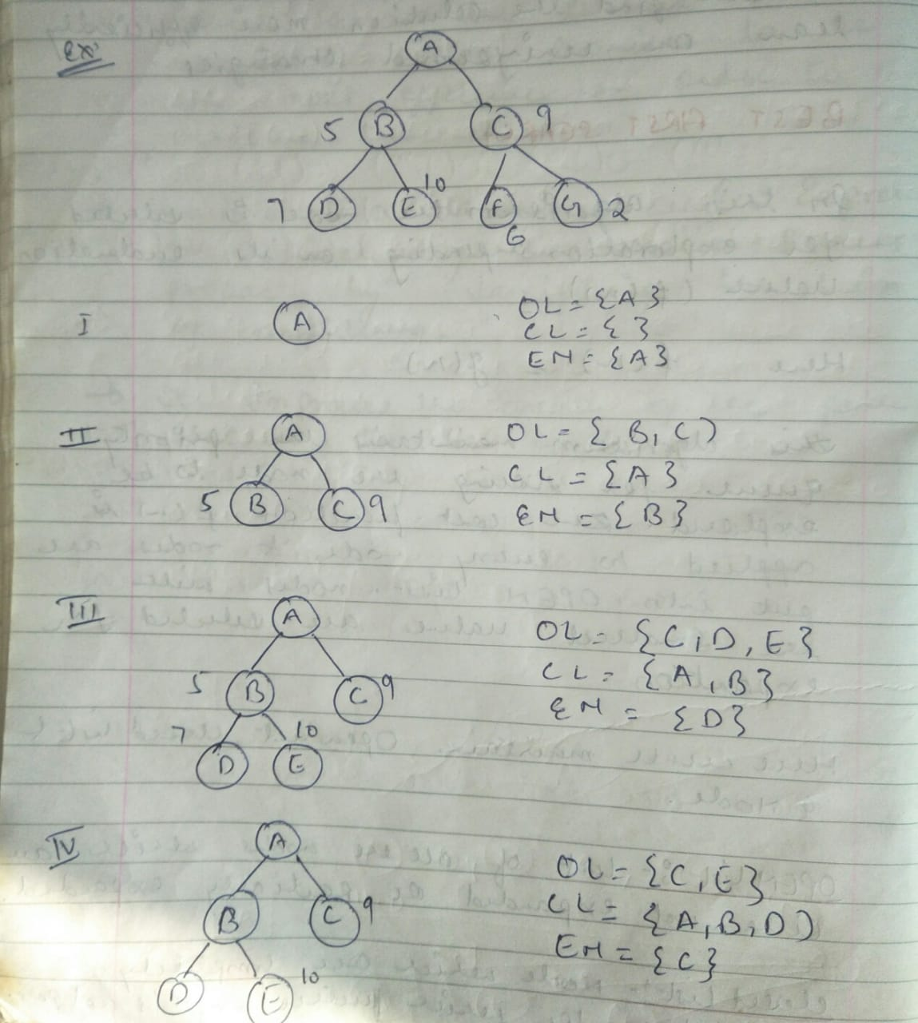
Example:best first search

Slide 61
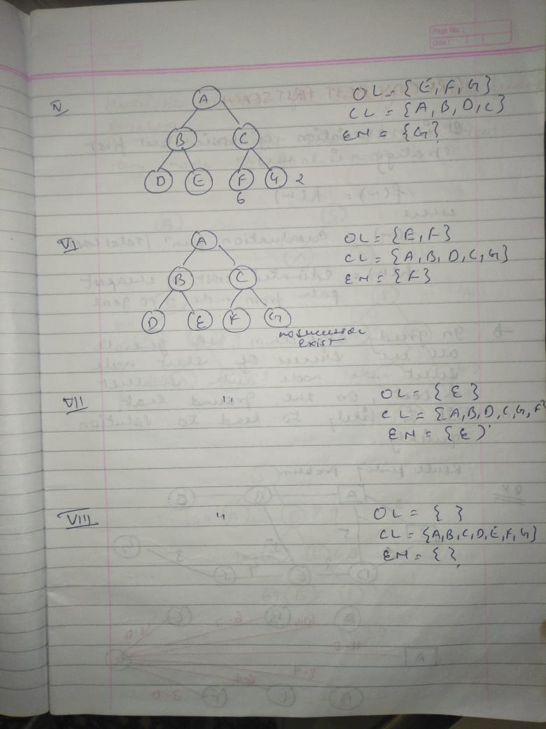
example best first search

Slide 62
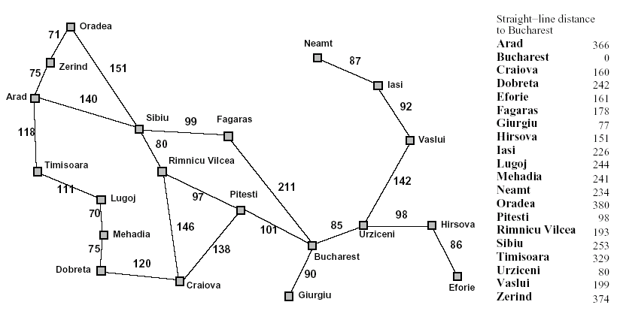
Heuristic Search : Heuristic Function
Heuristic Fn, f(n) = g(n) = distance between cities

Slide 63
Heuristic Search :Greedy-Best Search
Tries to expand the node that is closest to the goal.
Evaluates using only heuristic function : f(n) = h(n)
Possibly lead to the solution very fast.
Problem ? ~ can end up in sub-optimal solutions (doesn’t take notice of the distance it travels).

Slide 64
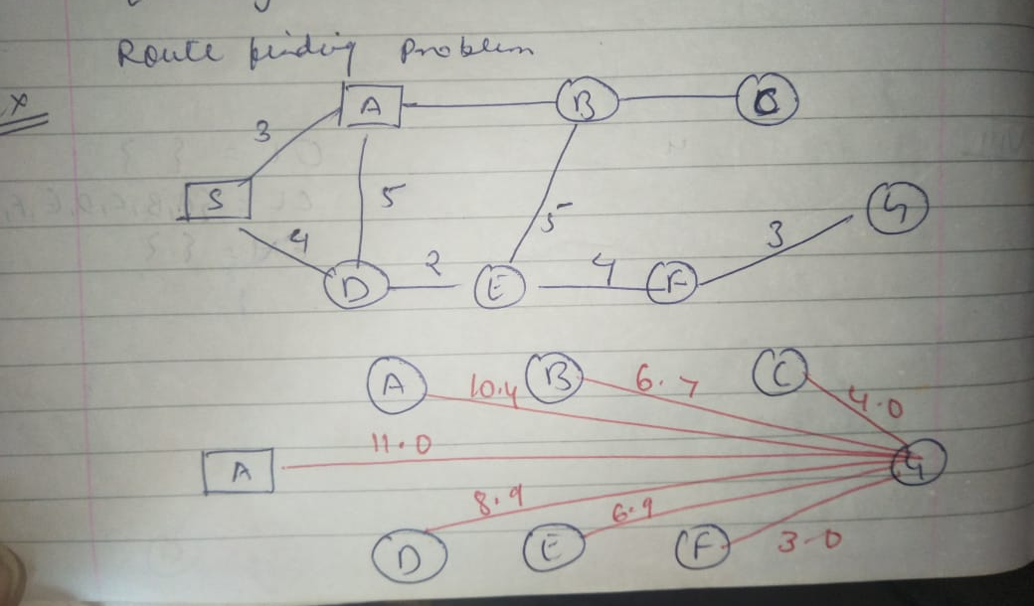
Example:Greedy best first Search

Slide 65
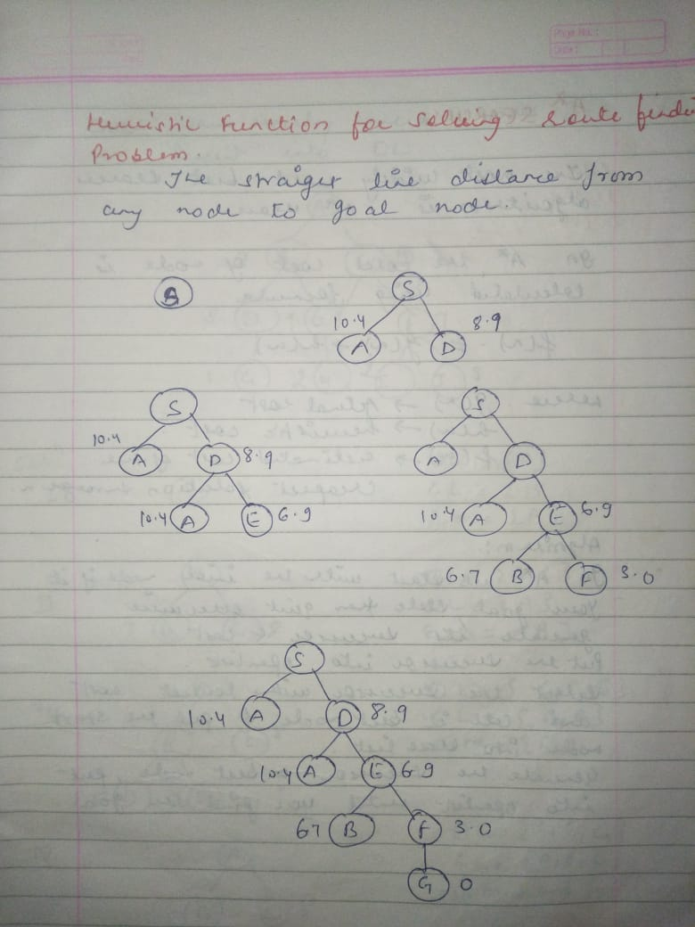
Example:Greedy best first Search

Slide 66
Heuristic Search : Heuristic Function
Distance: heuristic function can be straight line distance (SLD)

Slide 67
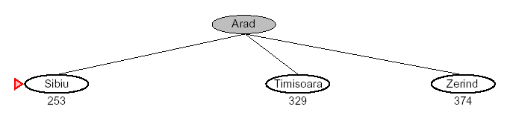
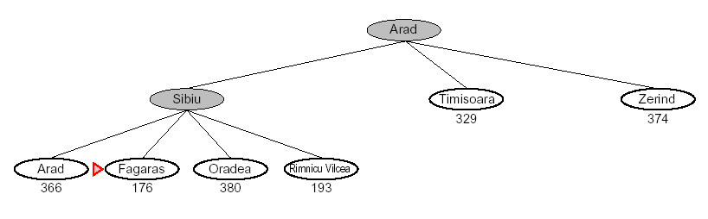
Heuristic Search :Greedy-Best Search
1
2

Slide 68
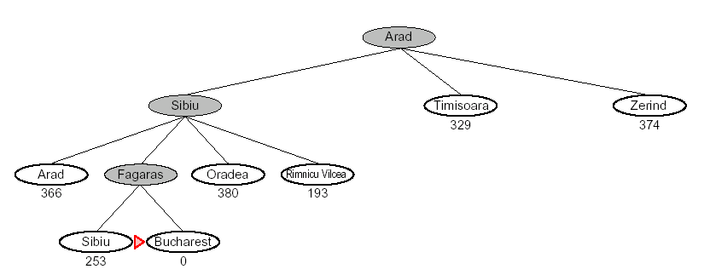
Heuristic Search :Greedy-Best Search
3

Slide 69
Heuristic Search : A* Algorithm
Widely known algorithm – (pronounced as “A star” search).
Evaluates nodes by combining g(n) “cost to reach the node” and h(n) “cost to get to the goal”
f(n) = g(n) + h(n),
f(n) 🡪 estimated cost of the cheapest solution.
Complete and optimal ~ since evaluates all paths.
Time ? ~ a bit time consuming
Space ? ~ lot of it!

Slide 70
Heuristic Search : A* Algorithm
S
:10
2
3
A
D
:9
:8
5
2
3
1
E
G’
G
H
:4
:0
:0
:3

Slide 71
Heuristic Search : A* Algorithm
Path cost for S-D-G
S
:10
f(S) = g(S) + h(S) = 0 + 10 🡪 10 f(D) = (0+3) + 9 🡪 12 f(G) = (0+3+3) + 0 🡪 6
Total path cost = f(S)+f(D)+f(G)🡪 28
2
3
A
D
:9
:8
5
2
3
1
Path cost for S-A-G’
E
G’
G
H
f(S) = 0 + 10 🡪 10 f(A) = (0+2) + 8 🡪 10 f(G’) = (0+2+2) + 0 🡪 4
Total path cost = f(S)+f(A)+f(G’)🡪 24
:4
:0
:0
:3
* Path S-A-G is chosen = Lowest cost

Slide 72
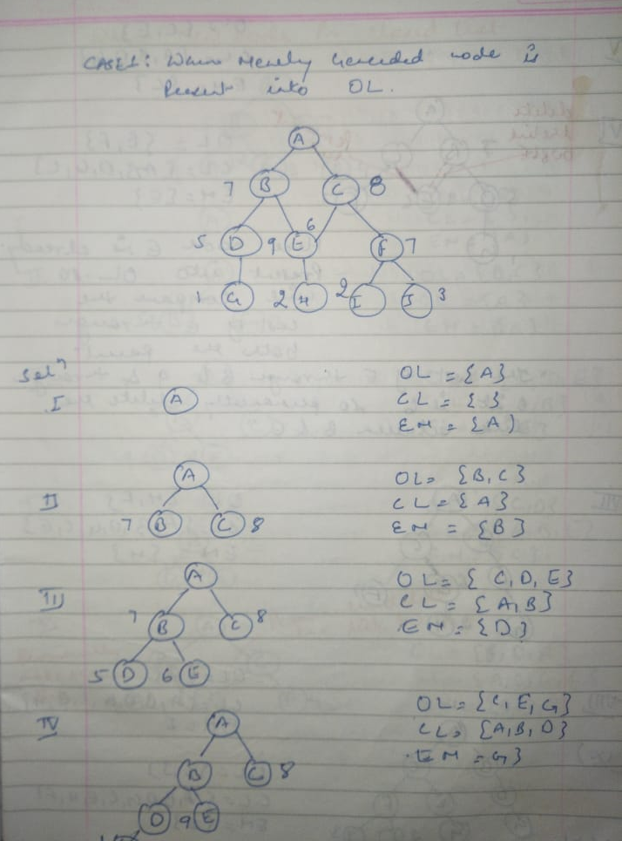
Example:A* Search(new node is in open list

Slide 73
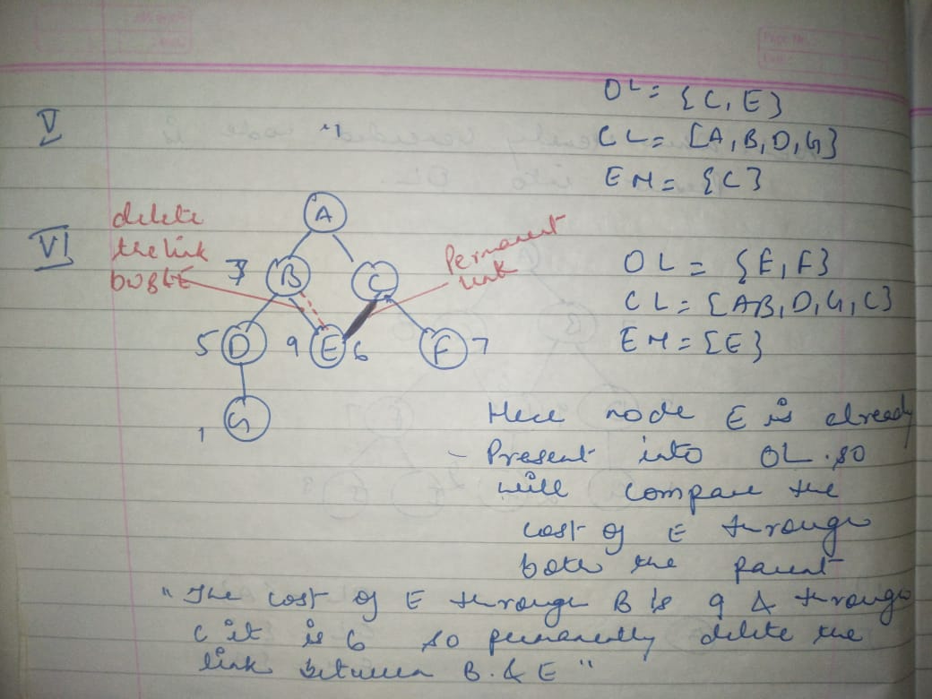
Example:A* Search(new node is in open list

Slide 74
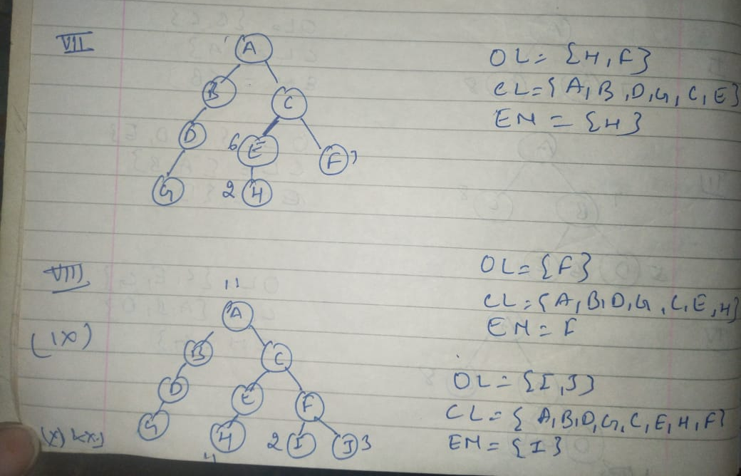
Example:A* Search(new node is in open list

Slide 75
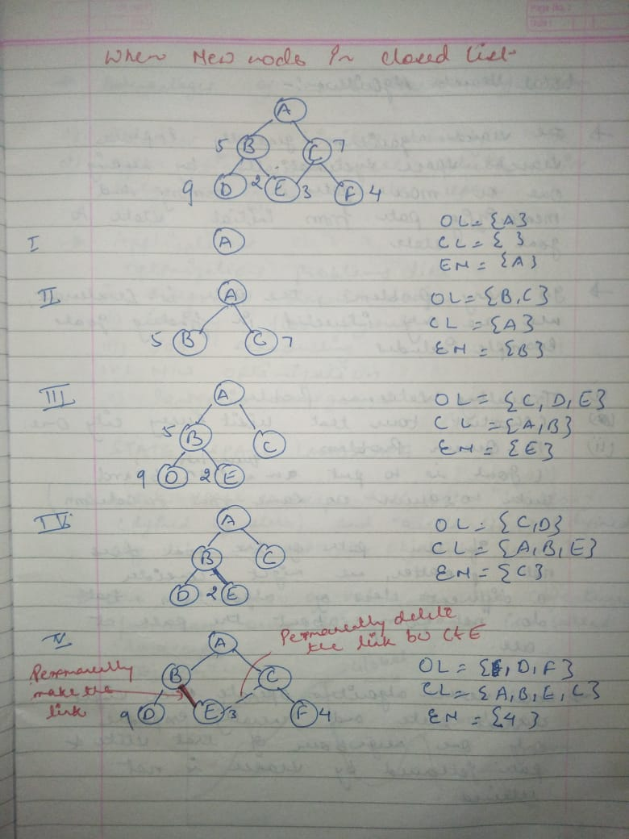
Example:A* Search(new node is in closed list

Slide 76


Heuristic Search : A* Algorithm

Slide 77

Heuristic Search : A* Algorithm

Slide 78

Heuristic Search : A* Algorithm

Slide 79

Heuristic Search : A* Algorithm

Slide 80

Heuristic Search : A* Algorithm

Slide 81
References
https://slideplayer.com/slide/9787248/
https://www.slideshare.net/RenasRekany/ai-local-search
https://slideplayer.com/slide/8514257/

